Slide 1
Predicting First Responder Need
Minori Jaggia, Rhea Sali, Eva Sidlo

Slide 2
Introduction
Given the resurgence of the Black Lives Matter movement and the call to defund the police, we chose to examine San Francisco crime to help determine what other types of first responders are necessary, when, and where. This can be helpful for first response departments to determine staffing needs and to help prepare staff for the type of emergencies they may have to respond to.
Notes:
Describe your research question(s) and discuss the project context and motivation (what makes it important and to whom)

Slide 3
Dataset
Police Incident Reportings Dataset
Incident reportings from sfgov.org from 2018-2020
Includes features such as:
‘Incident Time’
‘Incident Location’
‘Police District’
‘Analysis Neighborhood’
‘Incident Type’
‘Incident Description’, etc.
Total 65,534 rows and 16 features
U.S. Census Demographics Dataset
Manually inputted from reports based on 2010 U.S. Census and 2017 ACS survey
Included neighborhood statistics for ‘Analysis Neighborhood’ such as:
‘Percent Female’
‘Percent with College Degree’
‘Median Rent’
‘Percent Black/African American’
‘Percent White’, etc.
Total 21 features added for each row
Notes:
Describe the raw dataset (where or how did you collect it, how many rows, how many features, what are the features, etc)
'Percent Female', 'Single Family Homes Percent', 'Apartment Buildings Percent',
'Median Rent', 'Median Home Value', 'Median Household Income', 'Percent in Poverty', 'Unemployment Rate',
'Percent Asian', 'Percent Black/AA', 'Percent White', 'Percent Native American/Hawaiian', 'Percent Latinx',
'High School Degree or less', 'College Degree', 'Graduate Degree/PhD', 'Foreign Born', 'Median Age',
'English Speaking (only)', 'Spanish Speaking (only)', 'Asian Language Speaking',

Slide 4
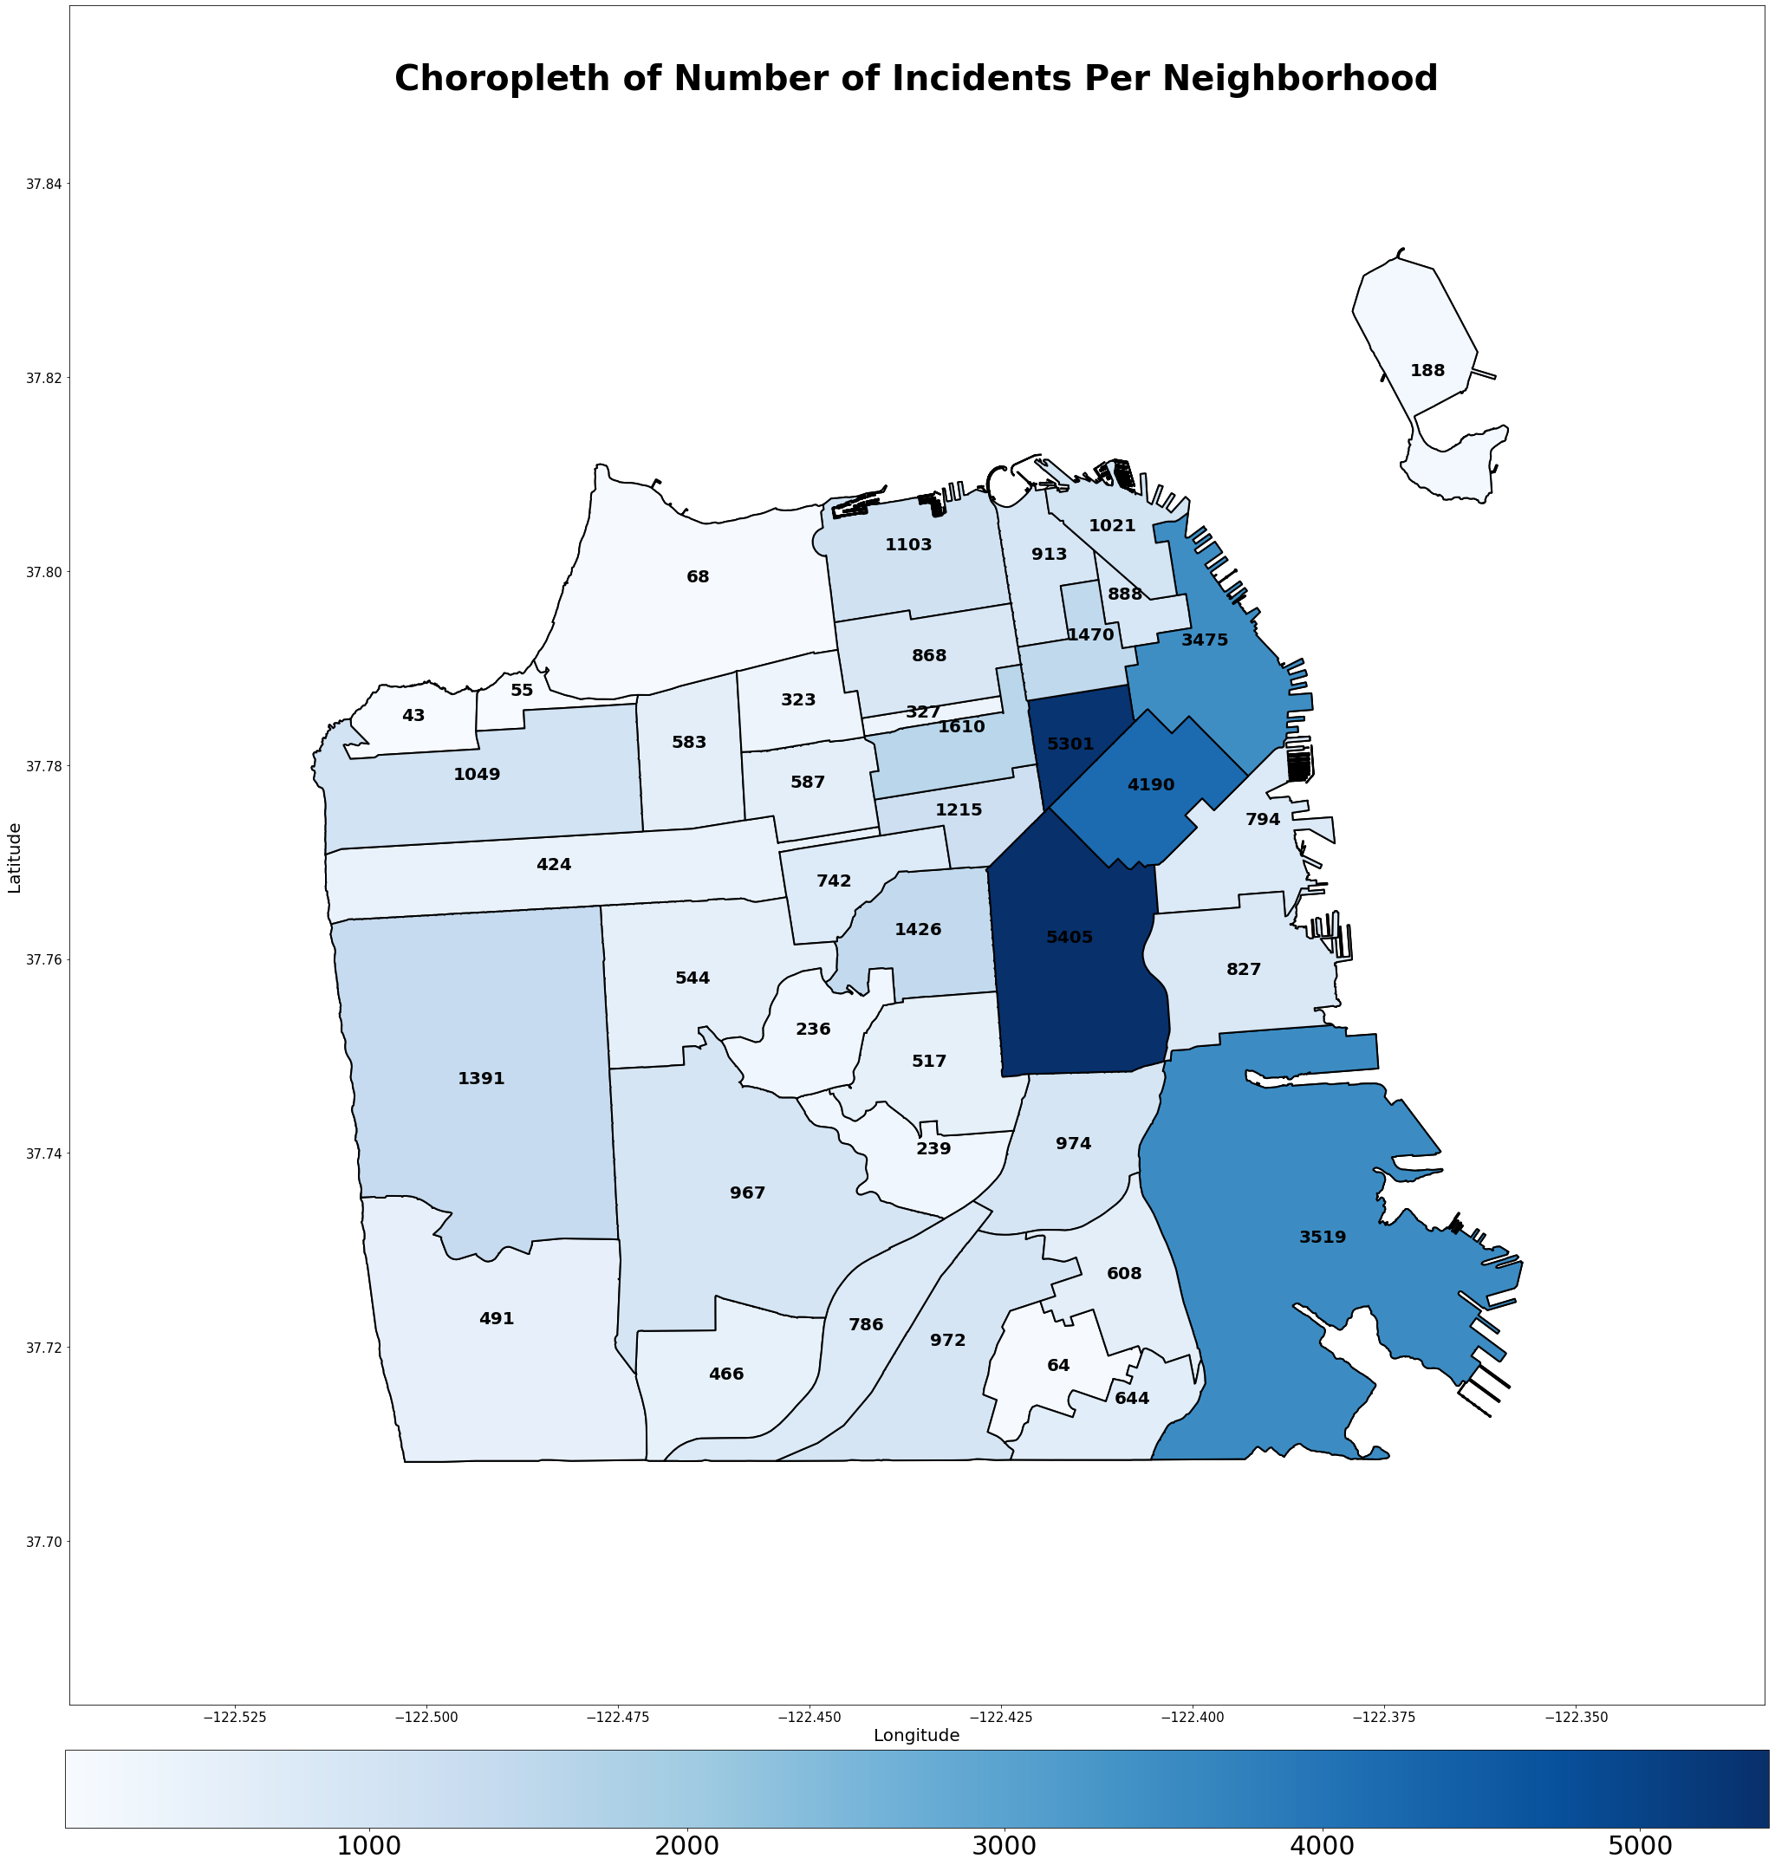
Exploratory Data Analysis
We began our project by looking into both data sources to understand if there were any patterns in type of crime (ie. higher crime on certain days, at certain times, in certain areas, in areas with given population statistics, etc.)
Starting off with ‘Analysis Neighborhood’, we can see that certain neighborhoods have a lot more crime than others.
Number of Incidents
Introduction | Dataset | Approaches | Results

Slide 5
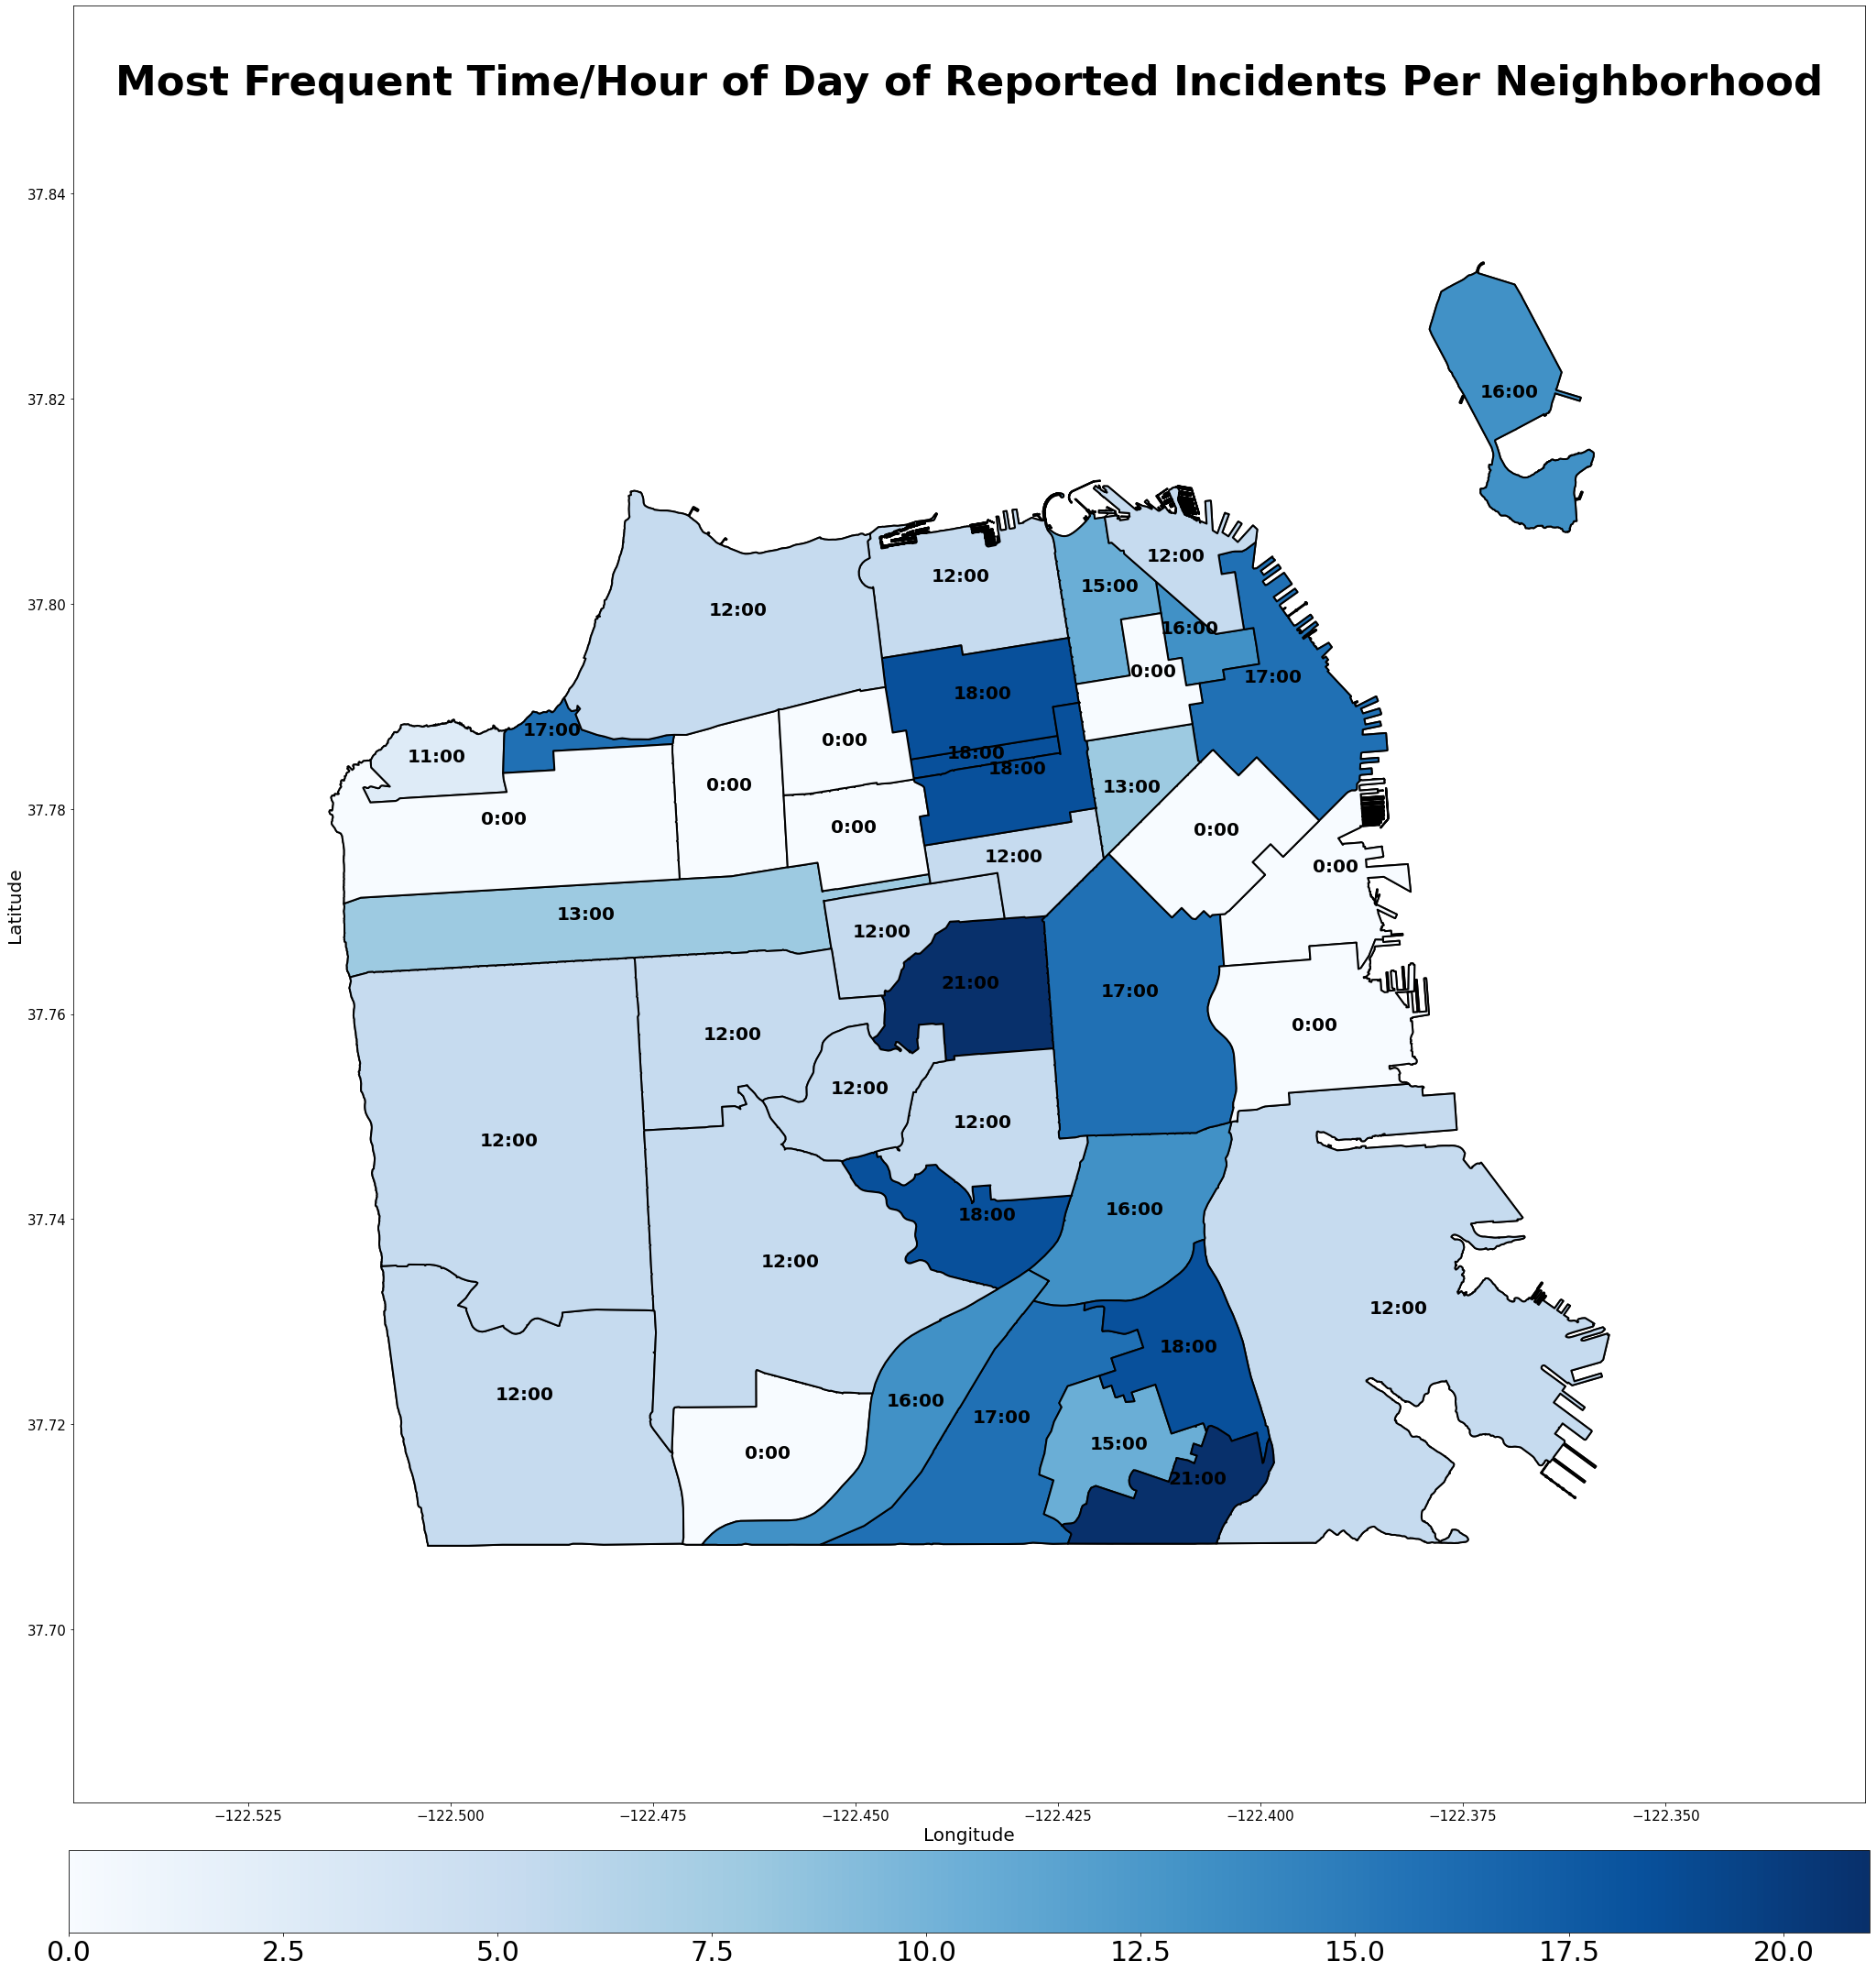
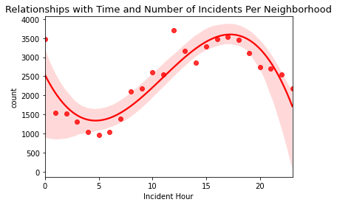
Hour of Day
Introduction | Dataset | Approaches | Results
Notes:
Here we have a map of the most frequent hour of day that the most incidents occur in a given neighborhood on the left.
We can see that there is a sinusoidal relationship occurring within time and number of crimes that peaks at about 15:00-17:00 (i.e. 3:00pm to 5:00pm)
These graphs detail the relationship between a given crime’s time and location. In our feature engineering we utilized information on the time of the incident to help predict the category that the incident belonged to.

Slide 6
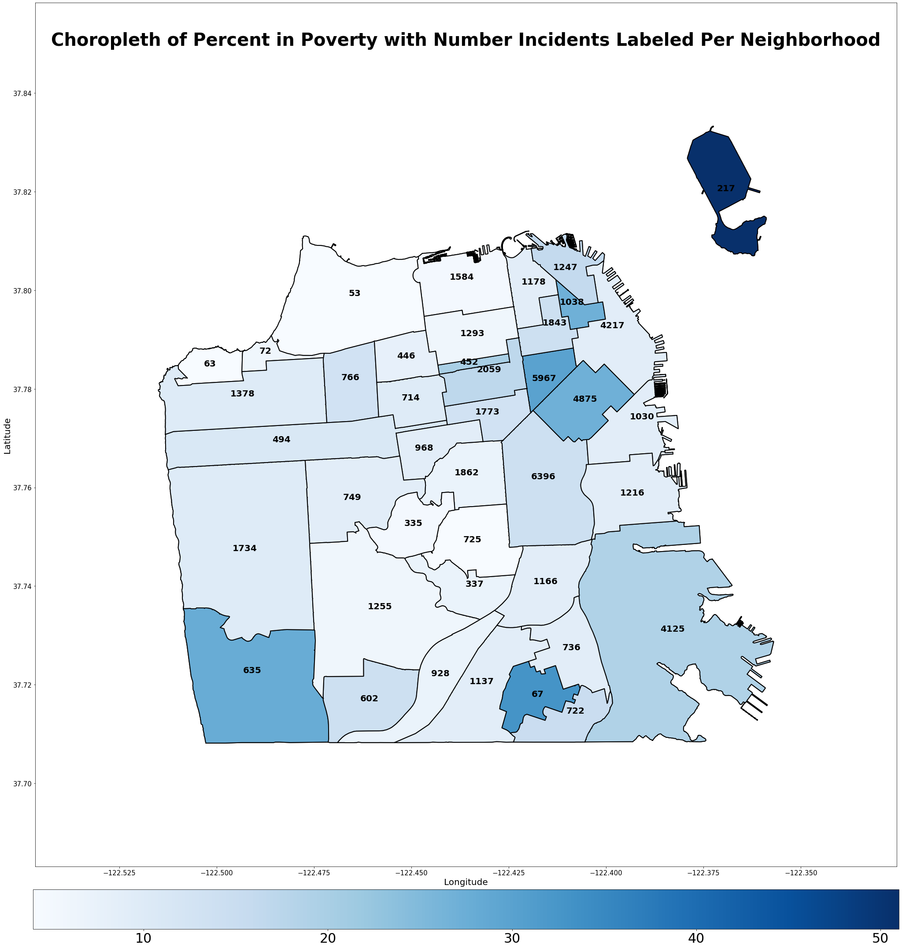
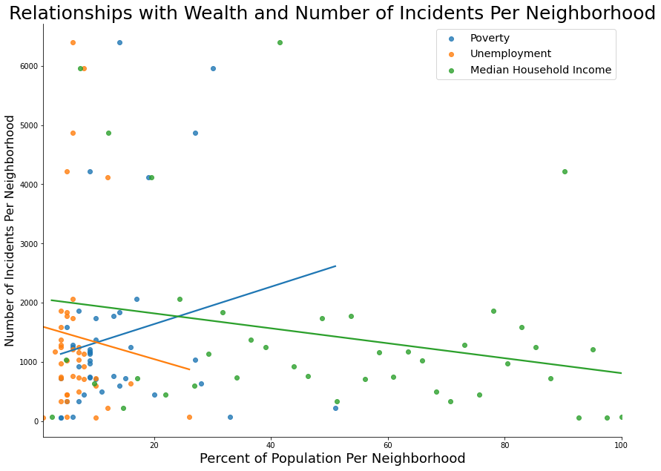
Percent in Poverty
Introduction | Dataset | Approaches | Results
Notes:
On the right, you can see a graph of the number of incidents as the following statistics change: “poverty rate”, “unemployment rate”, and “median household income”. From this, we can see that as the number of incidents decreases the median household income increases. Further, we can see that as the poverty rate increases, the number of incidents also increases. These are expected patterns. What is surprising is that as the unemployment rate increases, the number of cases decreases. But this may be reconciled by the fact that most of the neighborhoods have low unemployment but the number of incidents is scattered.
That is why, for further inspection, we chose to look more into the percent in poverty.
On the left we have another map of the total number of incidents per neighborhood with poverty levels colored beneath.

Slide 7
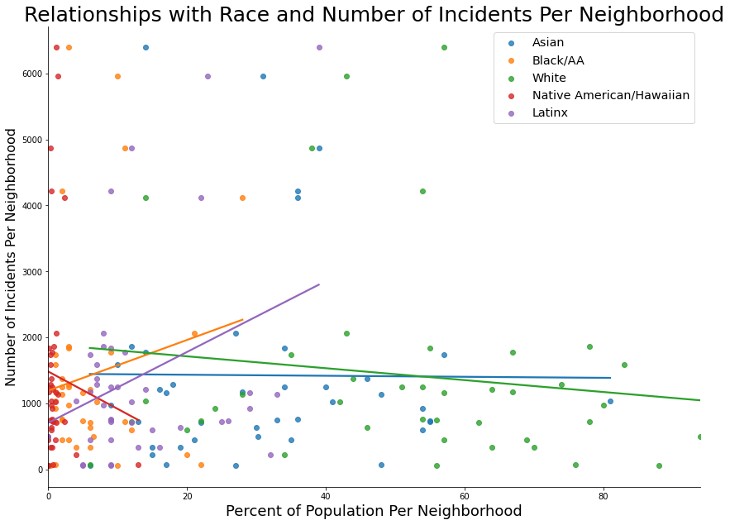
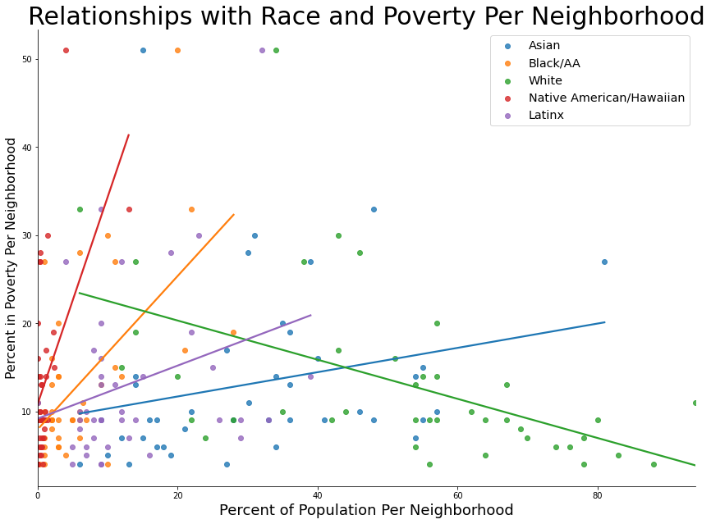
Introduction | Dataset | Approaches | Results
Notes:
This graph shows the relationship between racial statistics for neighborhoods and number of incidents reported. From the ACS data, we found data on the percentage of white, black/african american, asian, latinx, and native populations in each neighborhood. We looked at this to see if there were any obvious relationships between the race populations and the number of incidents because there are inherent biases that would say as the number of POC in a neighborhood increases, the more incidents there will be.
Our data shows, as the number of white, asian, and native populations increase, the less crime there is. However, as the Latinx and Black population increase, the more crime there is.
In order to determine if there is omitted variable bias that causes the incidents to increase as POC populations increase, we looked at correlations between race populations and other statistics such as the poverty rates. With this we found, that as POC populations increased in a neighborhood, the percent in poverty also increased whereas as the white population increases, the poverty percentage decreases.

Slide 8
Introduction to Approaches
Concepts Explored:
Data Cleaning
Feature Engineering
Random Forest
Neural Network
Cross Validation
Notes:
Describe the concepts from the class you used to approach the problem on hand. You may use algorithms not covered in class.

Slide 9
Grouping Response Variable
Since our purpose was to determine which types of first responders were necessary, we grouped our response variables into the following categories:
Crime without Assault/Endangerment
'Driving, Failure To Heed Red Light And Siren'
'Theft, Shoplifting, Att.'
Crime with Assault/Endangerment
'Assault, Aggravated, W/ Gun'
'Weapon, Deadly, Carrying with Intent to Commit Assault'
EMT
'Suicide, Attempted'
'Aided Case'
Social Workers
'Child Abuse, Exploitation'
'Civil Sidewalks, Violation'
'Mental Health Detention'
Fire Department
'Arson'
'Fire, Unlawfully Causing'
Administrative
'Case Closure'
'Search Warrant Service'
Introduction | Dataset | Approaches | Results

Slide 10
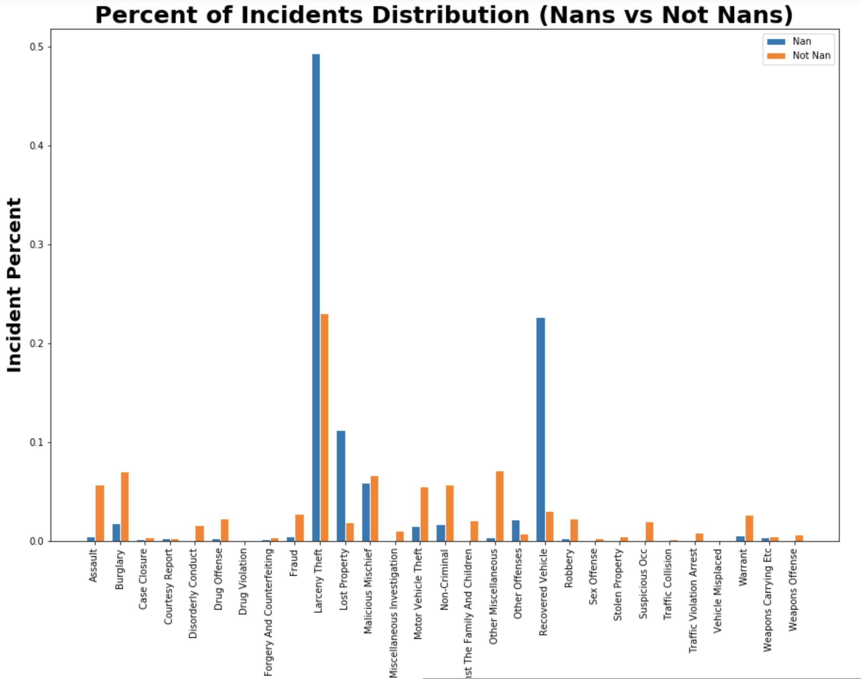
Data Cleaning - Dealing with NaNs
Counted number of occurrences of each type of incident before dropping NaN values
Filled in average values by police district for neighborhood demographics
Dropped all other NaNs
Number of rows after dropping: 58,454
Introduction | Dataset | Approaches | Results

Slide 11
Feature Engineering - Time & Location
Hour: 3 Approaches
One-hot encode incident hour directly
One-hot encode hour groupings by time, i.e. “Late Night”, “Early Morning”
One-hot encode hour groupings by most incident reports, i.e. “First Highest Crime Hours” where this would include all hours that ranked substantially higher in number of incidents
Day of Week: One-hot encoded, i.e. “Monday”, “Tuesday”, etc.
Week of Month: One-hot encoded, i.e. “First Week”, “Second Week”, etc.
Month: 2 Approaches
One-hot encode incident month directly
One-hot encode seasons, i.e. “Winter”, “Spring”, etc.
Year: One-hot encoded, i.e “2018”, “2019”, etc.
Analysis Neighborhood (districts shown on map earlier): One-hot encoded
Introduction | Dataset | Approaches | Results

Slide 12
Feature Engineering - Demographics
Gender
Percent Female
Household
Single Family Homes Percent
Apartment Buildings Percent
Wealth
Median Rent
Median Home Value
Median Household Income
Percent in Poverty
Unemployment Rate
Race
Percent Asian
Percent Black/AA
Percent White
Percent Native American/Hawaiian
Percent Latinx
Education
High School Degree or less
College Degree
Graduate Degree/PhD
Language
English Speaking (only)
Spanish Speaking (only)
Asian Language Speaking
Background
Foreign Born
Age
Median Age
*all features are numerical and were normalized using MinMaxScaler
Introduction | Dataset | Approaches | Results

Slide 13
Random Forest Classifier & Evaluation
Used Sci-kit Learn’s Random Forest Classifier
Implemented GridSearch to help find best parameters:
n_estimators = 500
max_depth = 25
min_samples_split = 2
min_samples_leaf = 1
oob_score = True
n_jobs = -1
Reasons for classifier choice:
Can predict multinomial output
Interpretable results (aka feature importances)
Higher accuracy than MLP neural network
 | Accuracy
Entire Dataset | 63.0%
Cross Validation | 58.6%
Introduction | Dataset | Approaches | Results

Slide 14
Takeaways
Predicting the type of first-responder needed is not a simple task
There are many factors that lead to the types of incidents reported in SF
Quite a bit of these incidents are more-or-less random
This leads to our relatively low cross validation score
Still, this model is a good base to build a higher accuracy prediction tool, which can be extremely useful in identifying which type of first responders should be sent.
Note that a cross validation accuracy of 58.6% is far better than the baseline of 16.6% (since there are 6 categories)
Our exploratory data analysis is also key in understanding how to allocate funds/personnelle in each neighborhood
Ex. Some neighborhoods should perhaps have more social workers assigned than police
Introduction | Dataset | Approaches | Results

Slide 15
Results & Conclusions
Based on the time, location, and demographics of a location one can predict the general category of a crime and respond correctly with the best person(s) to mediate the situation (i.e. trained professionals arriving to a scene that are suited for the incident type such as a Social Worker)
This will help local politicians/policy makers make better informed decisions regarding allocation of resources for responses to crime incidents.
Notes:
Results and Conclusions: Synthesize individual work and provide findings and conclusions. Do not forget to mention the real-world implications of your project and its results. Would you say it's ready to be used in the real-world yet? If not, what needs to be solved before you would say it was ready?

Slide 16
Example Use Case
Incident Date Incident Time Incident Year Incident Day of Week Supervisor District Analysis Neighborhood | 2018/03/11 10:44 2018 Sunday 8.0 Castro/Upper Market
Model Prediction: ‘Crime Without Endangerment’
Based on the inputted values given our model would predict this incident to fall under the category of ‘Crime Without Endangerment’. Instead of dispatching a police officer another type of trained professional such as a Social Worker can be utilized to assist this situation potentially.
Introduction | Dataset | Approaches | Results

Slide 17
Suggestions for Improvement
Adjusting the proportion needed in classifying certain categories could decrease accuracy, but increase effectiveness
Ex. Cases that are borderline Assault/Endangerment and might need police aid but would have been predicted as a different category, could be adjusted to predict Assault/Endangerment just to be safe
Adjust groupings for types of first responders
More or less specificity or adjusted bins could aid in prediction accuracy, but blur the meaning of the results and decrease usefulness
Add additional features
Ex. Holistic knowledge of history of crime in certain areas
Ex. Data regarding the type of businesses/land most common in each neighborhood
Filter the data for only certain types of cases (see next slide)
Introduction | Dataset | Approaches | Results

Slide 18
Filtering the Data for Better Prediction
Sample categories left after filtering:
Pros of Filtering:
Filtering data increased the cross validation score of predictions. We could successfully predict certain categories of the data that may be useful for specific purposes.
Cons of Filtering:
Filtering the data/using a smaller model is adverse to real world applications for actual prediction purposes. The accuracy would decrease because the algorithm can only predict certain categories.
'Homicide' 'Miscellaneous Investigation' 'Assault' 'Drug Offense' 'Malicious Mischief' 'Sex Offense' 'Non-Criminal' 'Drug Violation' 'Weapons Carrying Etc' 'Suspicious Occ' 'Weapons Offense' 'Disorderly ‘Conduct' 'Offences Against The Family And Children' ‘Other' | 'Family Offense' 'Civil Sidewalks' 'Liquor Laws' ‘Other Offenses' 'Prostitution', 'Suspicious' 'Suicide' ‘Rape' 'Human Trafficking (A), Commercial Sex Acts' 'Human Trafficking, Commercial Sex Acts' 'Weapons Offence' 'Juvenile Offenses' 'Other Miscellaneous' 'Robbery'
Filtering the data limits the model’s applicability to most real world datasets. If the model tried to predict an incident that wasn’t within the filtered incident categories there could be detrimental damage. Once the data has been narrowed down it sacrifices the potential usage of dispatching the correct responder to a specific incident.
Introduction | Dataset | Approaches | Results

Slide 19
Further Analysis
After developing a more thorough model, we can try to answer: How many first responders are necessary in each department during different times of the day and on different days of the week?
After implementing new first responders, we can explore the effectiveness of having different first responders show up instead of having police officers arrive for every type of case.
We could also begin determining preventative measures if the crime location and time is known/predictable and then later study the effectiveness of such measures.
Introduction | Dataset | Approaches | Results

Slide 20
Questions?

Slide 21
Appendix

Slide 22
SF Police Data
https://data.sfgov.org/Public-Safety/Map-of-Police-Department-Incident-Reports-2018-to-/jq29-s5wp

Slide 23
ACS/Census Data for SF Neighborhoods
https://default.sfplanning.org/publications_reports/SF_NGBD_SocioEconomic_Profiles/2012-2016_ACS_Profile_Neighborhoods_Final.pdf

Slide 24
Groupings - Crime Without Endangerment
'Theft, From Locked Vehicle, >$950', 'Theft, Other Property, $50-$200', 'Embezzlement from Dependent or Elder Adult by Caretaker', 'Theft, Shoplifting, $200-$950', 'Theft, From Building, Att.', 'Theft, From Person, >$950 (other than Pickpocket)', 'Theft, From Person, $200-$950 (other than Pickpocket)', 'Theft, From Locked Vehicle, $200-$950', 'Burglary, Vehicle (Arrest made)', 'Theft, Pickpocket, $50-$200', 'Theft, From Unlocked Vehicle, >$950', 'Theft, From Locked Vehicle, <$50', 'Theft, Shoplifting, $50-$200', 'License Plate, Stolen', 'Theft, Other Property, >$950', 'Theft, From Building, $200-$950', 'Theft, From Locked Vehicle, Att.', 'Theft, From Locked Vehicle, $50-$200', 'Theft, Shoplifting, <$50', 'Theft, Lost Property, Petty', 'Theft, From Building, $50-$200', 'Theft, From Unlocked Vehicle, $200-$950', 'Theft, Bicycle, Att.', 'Theft, Pickpocket, <$50', 'Theft of Checks or Credit Cards', 'Theft, From Building, >$950', 'Theft, From Person, <$50 (other than Pickpocket)', 'Theft, From Building, <$50', 'Theft, Shoplifting, >$950', 'Burglary, Vehicle, Att. (Arrest made)', 'Theft, Pickpocket, $200-$950', 'Theft, Other Property, $200-$950', 'Theft, From Unlocked Vehicle, $50-$200', 'Theft, Bicycle, $200-$950', 'Theft of Computers or Cell Phones', 'Theft, Petty, with Prior Conviction', 'Theft, Bicycle, >$950', 'Theft, Bicycle, $50-$200', 'Theft from Merchant or Library', 'Theft, From Person, $50-$200 (other than Pickpocket)', 'Theft, Shoplifting, Att.', 'Theft, Other Property, <$50', 'Theft, Lost Property, Grand', 'Theft, Pickpocket, >$950', 'Theft, Vehicle Strip, >$950', 'Theft of Other Property, Att.', 'Theft, Vehicle Strip, $200-$950', 'Theft of Animals (general)', 'Theft, From Unlocked Vehicle, <$50', 'Theft, From Unlocked Vehicle, Att.', 'License Plate or Tab, Theft of', 'Theft, Coin Operated Machine, >$950', 'Theft, Drunk Roll, >$950', 'Theft, Vehicle Strip, <$50', 'Theft, Drunk Roll, $200-$950', 'Theft, Coin Operated Machine, $200-$950', 'Theft of Utility Services', 'Theft, Purse Snatch, <$50', 'Theft, Motorcycle Strip, $200-$950', 'Theft, Vehicle Strip, Attempted', 'Theft, Vehicle Strip, $50-$200', 'Theft, Purse Snatch, $200-$950', 'Theft, From Person, Att. (other than Pickpocket)', 'Looting during State of Emergency', 'Theft, Bicycle, <$50, no serial number', 'Theft, Purse Snatch, >$950', 'Theft of Telecommunication Services, incl. Clone Phone', 'Theft, Drunk Roll, $50-$200', 'Theft, Coin Operated Machine, $50-$200', 'Theft, Purse Snatch, $50-$200', 'Theft, Boat', 'Theft, Motorcycle Strip, >$950', 'Burglary, Residence, Forcible Entry', 'Burglary, Apartment House, Forcible Entry', 'Burglary, Hot Prowl, Forcible Entry', 'Burglary, Other Bldg., Forcible Entry', 'Burglary, Apartment House, Unlawful Entry', 'Burglary, Other Bldg., Unlawful Entry', 'Burglary, Apartment House, Att. Forcible Entry', 'Burglary, Residence, Unlawful Entry', 'Burglary, Store, Unlawful Entry', 'Burglary, Non-residential, Forcible Entry', 'Burglary, Hot Prowl, Unlawful Entry', 'Burglary, Non-residential, Unlawful Entry', 'Burglary, Warehouse, Forcible Entry', 'Burglary, Safe, Store', 'Burglary, Store, Forcible Entry', 'Burglary, Residence, Att. Forcible Entry', 'Burglary, Residence Under Constr, Forcible Entry', 'Burglary, Other Bldg. Under Constr., Forcible Entry', 'Burglary, Warehouse, Unlawful Entry', 'Burglary, Other Bldg. Under Constr., Unlawful Entry', 'Burglary, Hotel Room, Unlawful Entry', 'Burglary, Flat, Unlawful Entry', 'Burglary, Store, Att. Forcible Entry', 'Burglary, Other Bldg., Att. Forcible Entry', 'Burglary, Non-residential, Att. Forcible', 'Burglary, Residence Under Constr, Unlawful Entry', 'Burglary, Hot Prowl, Att. Forcible Entry', 'Burglary, Flat Under Constr., Att. Forcible', 'Burglary, Flat Under Constr., Forcible Entry', 'Burglary, Apt Under Constr., Unlawful Entry', 'Burglary, Apt Under Constr., Forcible Entry', 'Burglary, Other Bldg. Under Constr., Att. Forcible', 'Burglary, Warehouse, Att. Forcible Entry', 'Burglary, Hotel Room, Forcible Entry', 'Burglary, Flat, Forcible Entry', 'Burglary, Hotel Under Constr., Forcible Entry', 'Burglary, Safe, Residence', 'Burglary, Safe, Warehouse', 'Burglary, Apt Under Constr., Att. Forcible', 'Burglary, Warehouse Under Constr, Unlawful Entry', 'Burglary, Flat Under Constr., Unlawful Entry', 'Burglary, Residence Under Constr, Att. Forcible', 'Burglary, Flat, Att. Forcible Entry', 'Burglary, Safe, Other', 'Burglary, Hotel Under Constr., Unlawful Entry', 'Stolen Property, Possession with Knowledge, Receiving', 'Stolen Computer, Possession', 'Money, Property or Labor, Fraudulently Obtaining', 'Stolen Cellular Phone, non-cloned, Possession', 'Stolen Access Card, Possession', 'Stolen Electronics, Possession', 'Stolen Checks, Possession', 'Lost Property', 'Embezzlement (general)', 'Embezzlement, Grand Theft By Employee', 'Embezzlement, Grand Theft', 'Embezzlement, Petty Theft By Employee', 'Embezzlement, Petty Theft', 'Embezzlement, Petty Theft, Leased Property', 'Vehicle, Embezzled', 'Vehicle, Rental, Failure to Return', 'Embezzlement, Grand Theft Leased Property', 'Embezzlement, Grand Theft By Brokers/Agents', 'Counterfeit Money or Coins', 'Checks, False, Making, Uttering or Possessing', 'Forgery, Checks, Felony', 'Access Card or Signature, Forgery of', 'Checks, Blank or Forged, Fraudulent Possession', 'Forgery & Counterfeiting (general)', 'Counterfeit/Forgery, Poss Drivers Lic Or Id Card', 'Counterfeit Coins Or Notes, Possessing or Receiving', 'Vehicle Registration, False Evidence of', 'Counterfeiting, Coins Or Notes', 'Checks or Legal Instruments, Uttering Forged', 'Identification Card or Drivers License, Falsify or Display', 'VIN, Alter Or Remove', 'Access Card, incl. Credit, Phone, ATM, Fraudulent Use of', 'False Personation', 'False Personation to Receive Money or Property', 'Fraudulent Game or Trick, Obtaining Money or Property', 'Fraudulent Use Of Automated Teller Card', 'Access Card Information, Theft of', 'Checks, Making or Uttering with Insufficient Funds', 'Checks, Money Orders, Completed, Fraudulent Possession', 'Credit Application, Fraudulent', 'False Personation and Cheat Crimes (general)', 'Theft, Trick And Device, Felony',
'Injuring Phone, Cable TV, or Other Line', 'Driving, No License Issued', 'Lodging Without Permission', 'Unusual Occurrence', 'Driving, Reckless', 'Evading a Police Officer Recklessly', 'Driving, Speeding', 'Defrauding Providers of Food, Fuel, Services, or Accommodations', 'Threat or Force to Resist Executive Officer', 'Burglary Tools, Possession Of w/prior', 'Evading a Police Vehicle or Bicycle', 'Parole Violation, Adult', 'Narcotics Paraphernalia, Possession of', 'Methamphetamine Offense', 'Cocaine, Possession For Sale', 'Marijuana, Transporting', 'Cocaine, Base/rock, Possession For Sale', 'Methamphetamine, Possession For Sale', 'Heroin, Possession For Sale', 'Cocaine, Sale', 'Marijuana, Possession For Sale', 'Cocaine, Base/rock, Sale', 'Marijuana, Cultivating/Planting', 'Methamphetamine, Transportation', 'Cocaine Offense', 'Controlled Substance Offense', 'Heroin Offense', 'Controlled Substance, Possession For Sale', 'Controlled Substance, Sale', 'Loitering Where Narcotics are Sold/Used', 'Cocaine, Base/rock Offense', 'Hallucinogenic, Possession For Sale', 'Marijuana, Sales', 'Controlled Substance, Under the Influence of', 'Heroin, Sales', 'Controlled Substance, Transportation', 'Marijuana Offense', 'Opiates, Sale', 'Methamphetamine, Sale', 'Hallucinogenics Offense', 'Money Offense Related to Narcotics Trafficking', 'Opium Derivative, Possession For Sale', 'Opiates, Possession For Sale', 'Opiates Offense', 'Controlled Substance Violation, Loitering for', 'Methadone Offense', 'Methadone, Possession For Sale', 'Hallucinogenic, Sale', 'Prescription, Forge Or Alter (11368 H&S)', 'Amphetamine, Transportation', 'Amphetamine, Possession For Sale', 'Liquor Law Violation (general)', 'Alcohol, Unlawful Transportation Of', 'Alcohol, Possession Of By Minor', 'Alcohol, Sale Of To Minor', 'Hallucinogenic, Possession For Sale', 'Drugs, Under Influence in a Public Place', 'Dissuading/Threatening Of A Witness', 'Public Nuisance, Maintaining After Notification', 'Driving While Under The Influence Of Alcohol', 'Loitering Without Lawful Business With Owner or Occupant', 'State Code Felony (general)', 'Resisting Peace Officer, causing Their Serious Injury or Death', 'False Imprisonment', 'Fireworks, Possession of any within SF, incl. "Safe & Sane"', 'Fireworks, Exploding', 'Maintaining A Public Nuisance', 'State Code Misdemeanor (general)', 'Firefighter, Interfering with', 'Police Broadcast, Interception to Commit Crime', 'Public Transit Crimes - Infractions', 'Extortion or Blackmail', 'Impersonating A Police Officer', 'Rail Transit, Entering, Remaining, or Hindering Operation of', 'False Report of Emergency', 'Vehicle, Open Container Of Alcohol In', 'Extortion, Attempted', 'Interfering, W/ Police Officer', 'Prisoner, Rescuing From Lawful Custody', 'Vehicle, Throwing Substance At', 'Impersonating Public Utility Member', 'False Report of Felony or Misdemeanor', 'Chop Shop, Own or Operate', 'Threatening School or Public Employee', 'Abortion, Unlawful', 'Driving, Failure To Heed Red Light And Siren', 'Weapon, Taking or Attempting to Take from Peace Officer', 'Legal Instruments, Uttering False Checks, etc. (misd.)', 'Contraband, Taking Into A Reformatory', 'Lotteries (general)', 'Vehicle, Stolen, Auto', 'Vehicle, Stolen, Motorcycle', 'Vehicle, Stolen, Truck', 'Vehicle, Stolen, Other Vehicle', 'Vehicle, Stolen, Attempted', 'Vehicle, Stolen, Bus', 'Vehicle, Stolen, Mobile Home or House Trailer', 'Auto, Grand Theft of', 'Traffic Collision, Hit & Run, Injury', 'Traffic Collision', 'Traffic Collision, Hit & Run, Property Damage', 'Traffic Violation Arrest', 'Vehicle, Tampering', 'Vehicle, Impounded', 'Vehicle, Misplaced', 'Restraining Order Notification/Service of Restraining Order', 'Stay Away Order Violation, DVU related', 'Violation of Restraining Order', 'Violation of Emergency Protective Order', 'Violation of Stay Away Order', 'Stalking', 'Tobacco Products, Selling or Furnishing to Minor', 'ATM-related Crime (secondary code only)', 'Dog, Barking', 'Resisting, Delaying, or Obstructing Peace Officer Duties', 'Burglary, Safe, Store', 'Fireworks, Possession of any within SF, incl. "Safe & Sane"', 'Burglary, Safe, Warehouse', 'Burglary, Safe, Residence', 'Privacy, Invasion of (general)', 'Computer System, Accessing, Copying, or Damaging', 'Theft, False Pretenses, Felony', 'Access Card Counterfeiting Machinery, Possession of', 'Checks, Theft/Non-sufficient Funds, Felony', 'Identification, Government, Possess, Make or Sell False', 'Access Card Information, Publication of', 'Theft, Trick & Device, Misd.', 'Cellular or Cordless Phone Communications, Intercepting', 'Telephone or Telegraph Message, Sending False', 'Food Stamps, Misuse of', 'Access Card, Possession of Lost or Stolen, with Intent to Use, Transfer, or Sell', 'False Claims, Presenting to Government', 'Privacy, Invasion of (general)', 'Theft, False Pretenses, Misd.', 'Falsification of Medical Records', 'Audiovisual (Video or Sound) Recordings, Unauthorized', 'Theft, Trick And Device, Att.', 'Eavesdropping Devices, Sale or Use', 'Financial Statements, False', 'Insured Property, Destruction to Defraud Insurer', 'Park Code Violation (general)', 'Trash, Placing On The Street', 'Alcohol, Consuming In Public View', 'Municipal Code Violation (general)', 'Municipal Police Code Violation (general)', 'Defrauding Gas Station/Taxi Driver', 'Throwing Object at Common Carrier, Passenger or Freight', 'Obstructions On Streets, Sidewalks', 'Loitering and Peeking into Inhabited Structure', 'License Plate, Lost', 'License Plate, Found', 'Peddling Without A License', 'Fire Code Violation (general)', 'Permit Violation, Police (general)', 'Permit Violation, Entertainment', 'Federal Law Violation (general)', 'Hotel Violations', 'Public Transit, Acts Against', 'Burglary Tools, Possession Of', 'Conspiracy', 'Investigative Detention', 'Resisting, Delaying, or Obstructing Peace Officer Duties', 'Dissuading Witness, Victim', 'Identification To Peace Officer, False', 'Driving, License Suspended or Revoked', 'Trespassing', 'Driving While Under The Influence Of Drugs', 'Probation Violation',
Notes:
LMAO this looks like a terms of agreement

Slide 25
Groupings - Crime With Endangerment
'Miscellaneous Investigation', 'Assault, Aggravated, W/ Knife', 'Assault, Aggravated, W/ Other Weapon', 'Battery', 'Assault, Aggravated, W/ Gun', 'Assault, Aggravated, W/ Force', 'Battery, former Spouse or Dating Relationship', 'False Imprisonment', 'Assault, Mayhem, W/ Force', 'Battery with Serious Injuries', 'Assault, Non-Aggravated', 'Battery, Sexual', 'Shooting into Inhabited Dwelling or Occupied Vehicle', 'Battery, Of A Police Officer', 'Assault, Att. Homicide, W/ Other Weapon', 'Assault, W/ Caustic Chemical to Injure or Disfigure', 'Assault, Aggravated, On Police Officer, W/ Force', 'Firearm, Discharging in Grossly Negligent Manner', 'Assault, Att. Homicide, W/ Knife', 'Assault, Att. Homicide, W/ Force', 'Assault, Non-Aggravated, Att.', 'Assault, Att. Homicide, W/ Gun', 'Firearm, Discharging at Unoccupied Bldg, Vehicle or Aircraft', 'Assault, Att. Mayhem, W/ Gun', 'Assault, Att. Mayhem, W/ Force', 'Assault, Aggravated, On Police Off., W/ Other Weapon', 'Firearm, Discharging at Occupied Bldg, Vehicle, or Aircraft', 'Firearm, Discharging At An Inhabited Dwelling', 'Assault, Aggravated, On Police Officer, W/ Knife', 'Assault, Mayhem, W/ Knife', 'Firearm, Negligent Discharge', 'Robbery, W/ Force', 'Robbery, W/ Knife', 'Robbery, Att., W/ Force', 'Robbery, Street or Public Place, W/ Force', 'Robbery, Att., Street or Public Place, W/ Knife', 'Shoplifting, Force against Agent', 'Robbery, Att., Chain Store, W/ Force', 'Robbery, Chain Store, W/ Knife', 'Robbery, W/ Other Weapon', 'Robbery, Att., Street or Public Place, W/ Force', 'Robbery, Street or Public Place, W/ Gun', 'Robbery, Chain Store, W/ Force', 'Robbery, Comml. Establ. W/ A Knife', 'Robbery, W/ Gun', 'Carjacking with a Gun', 'Robbery, Att., W/ Gun', 'Robbery, ATM, Gun, Att.', 'Robbery, Residence, W/ Gun', 'Robbery, Comml. Establ., W/ Force', 'Robbery, Att., Comm. Establ., W/ Force', 'Robbery, Att., Comm. Establ. With Other Weapon', 'Robbery, Chain Store, W/ Gun', 'Robbery, Service Station, W/ Gun', 'Robbery, Street or Public Place, W/ Knife', 'Robbery, Street or Public Place, W/ Other Weapon', 'Robbery, Att., W/ Other Weapon', 'Robbery, Att., Chain Store, W/ Other Weapon', 'Robbery, Att., Street or Public Place, W/ Gun', 'Robbery, Residence, W/ Knife', 'Carjacking with Bodily Force', 'Robbery, Comml. Establ. W/ Weapon', 'Robbery, Chain Store, W/ Other Weapon', 'Robbery, Att., Residence, W/ Knife', 'Robbery, ATM, Gun', 'Robbery, Att., Bank, W/ Force', 'Robbery, Vehicle for Hire, Att., W/ Other Weapon', 'Robbery, Residence, W/ Force', 'Robbery, ATM, Force, Att.', 'Carjacking with a Knife', 'Robbery, ATM, Knife', 'Carjacking with a Dangerous Weapon', 'Robbery, Att., Street or Public Place, W/ Other Weapon', 'Robbery, ATM, Force.', 'Robbery, Att., W/ Knife', 'Robbery, Att., Bank, W/ Other Weapon', 'Robbery, Comml. Establ., W/ Gun', 'Robbery, ATM, Other Weapon', 'Robbery, Service Station W/ Other Weapon', 'Robbery, Residence, W/ Other Weapon', 'Robbery, Bank, W/ Force', 'Robbery, Bank, W/ Other Weapon', 'Robbery, Att., Residence, W/ Gun', 'Robbery, ATM, Knife, Att.', 'Firearm, Armed While Possessing Controlled Substance', 'Firearm, Loaded, in Vehicle, Possession or Use', 'Firearm, Possession of Loaded', 'Firearm, Possession By Prohibited Person', 'Firearm, Tampering With Marks', 'Weapon, Prohibited, Possession, Sale, Mfg., Import', 'Weapon, Assault, Possession, Manufacture, or Sale', 'Ammunition, Poss. By Prohibited Person', 'Weapon, Assault, Registration or Transfer Violation', 'Switchblade Knife, Possession', 'Weapon, Deadly, Carrying with Intent to Commit Assault', 'Firearm, Carrying Loaded with Intent to Commit Felony', 'Weapon, Possess or Bring Other on School Grounds', 'Weapon, Tear Gas, Possession by Prohibited Persons', 'Fire Bomb, Possession or Use', 'Firearm, Possession of While Wearing Mask', 'Weapon, Concealed, Loitering While Carrying', 'Weapon, Carrying Concealed', 'Weapon, Deadly, Possession W/ Intent To Assault', 'Weapon, Deadly, Imitation or Laser Scope, Exhibiting', 'Firearm, Discharging Within City Limits', 'Phone Calls, Harassing', 'Vandalism with Noxious Chemical', 'Animal, Cruelty to',
'Vandalism or Graffiti Tools, Possession', 'Malicious Mischief, Tire Slashing', 'Damage To Mail Box', 'Malicious Mischief, Street Cars/Buses', 'Fire Alarm, False', 'Parking Meters, Damage to', 'Malicious Mischief, Breaking Windows With BB Gun', 'Minor Beyond Parental Control', 'Fire Protection Equipment, Tampering with', 'Malicious Mischief, Building Under Constr.', 'Malicious Mischief, Annoying/Fictitious Phone Calls', 'Curfew Violation', 'Graffiti on Government Vehicles or Public Transportation', 'Terrorist Threats', 'Gang Related (secondary only)', 'Disturbing The Peace, Commotion', 'Phone Calls, Threatening', 'Disturbing The Peace', 'Disturbing The Peace, Fighting', 'Incident On School Grounds', 'Drugs, Under Influence in a Public Place', 'Alcohol, Under Influence Of In Public Place', 'School Property, Disturbance on', 'Public Nuisance, Committing', 'Phone Calls, Threatening or Annoying', 'Lodging in Park', 'School or Playground, Loitering About', 'Firearm Possession in School Zone', 'Disturbing The Peace, Swearing', 'Loitering, Obstructing', 'Assault on School Employee', 'Trespass within 30 days of Credible Threat', 'School Campus, Remaining Without Consent', 'Unlawful Assembly', 'Disturbing Religious Meetings', 'Engaging In Lewd Act', 'Riot', 'School, Public, Trespass', 'Lynching by Riot', 'Refusing To Disperse Upon Lawful Command', 'Suspicious Occurrence', 'Child, Suspicious Act Towards', 'Suspicious Occurrence, possible Shots Fired', 'Suspicious Act Towards Female', 'Suspicious Vehicle', 'Suspicious Person', 'Shooting, Accidental', 'Air Gun, Possession', 'Theft, Grand, of Firearm', 'Spouse, Cohabitee, Parent of Child in Common, Inflict Injury', 'Elder Adult or Dependent Abuse (not Embezzlement or Theft)', 'Domestic Violence (secondary only)', 'Hate Crime (secondary only)', 'Tarasoff Report', 'EPO or Restraining Order Violation, DVU related', 'Probation Violation, DVU related', 'Terrorizing by Arson or Explosive Device', 'Firearm, Turned In by Public', 'Dog, Bite or Attack', 'Dog, Stray or Vicious', 'Hazardous Materials, Dump any Substance into Water', 'Hazardous Materials, Dumping in Unauthorized Location', 'Suspicious Package', 'Missing Adult', 'Discharging Offensive or Injurious Substance in Public Area', 'Throwing Injurious Substance on Highway', 'Firearm with Altered Identification', 'Fireworks, Throw at Person or Discharge in Crowd', 'Driving While Under The Influence Of Alcohol, w/Injury', 'Bomb Threat or False Report of Bomb', 'Evading a Police Officer, Injury or Death', 'Driving While Under The Influence Of Drugs, w/Injury', 'Kidnapping (Adult victim)', 'Flammable or Explosive Device, Possession', 'Kidnapping during Robbery', 'Kidnapping during Carjacking', 'Kidnapping, Attempted (Adult victim)', 'Robbery, ATM, Gun, Att.', 'Robbery, ATM, Gun', 'Robbery, ATM, Knife, Att.', 'Hazardous Materials, Dump any Substance into Water', 'Robbery, ATM, Other Weapon', 'Robbery, ATM, Force.', 'Robbery, ATM, Force, Att.', 'Robbery, ATM, Knife', 'Human Trafficking (A)-Commerical Sex Acts', 'Pimping', 'Rape, Assault To, W/ Force', 'Rape, Forcible, W/ Force', 'Rape, Spousal', 'Oral Copulation, Unlawful (Adult Victim)', 'Rape, Assault To, W/ Gun', 'Rape, Forcible, W/ Sharp Object', 'Penetration, Forced, with Object', 'Unlawful Sexual Intercourse with Minor', 'Rape, Att., W/ Other Weapon', 'Rape, Att., W/ Force', 'Solicits For Act Of Prostitution', 'Pandering', 'Loitering for Purpose of Prostitution', 'Soliciting to Visit House Of Prostitution', 'Solicits Lewd Act', 'House of Prostitution, Keeping or Residing in', 'Soliciting or Engaging In Lewd Conduct', 'Caustic Chemical, Possession', 'Weapon, Carrying Concealed with Felony or Narcotics Conviction', 'Explosive Device, Located', 'Destructive Device, Possession', 'Destructive Device, Exploding', 'Malicious Mischief, Vandalism to Property', 'Malicious Mischief, Vandalism to Vehicle', 'Malicious Mischief, Breaking Windows', 'Malicious Mischief, Adult Suspect', 'Malicious Mischief, Graffiti, Real or Personal Property', 'Vandalism or Graffiti on or within 100 ft of Highway'

Slide 26
Groupings - EMT and Fire Department
EMT
'Aided Case', 'Aided case, Naloxone Deployment', 'Aided Case -Property for Destruction', 'Aided Case, Injured or Sick Person', 'Aided Case, Sick Person', 'Death Report, Cause Unknown', 'Death Report, Natural Causes', 'Death, Non-manslaughter Vehicle Accident', 'Death, Accidental', 'Homicide, W/ Gun', 'Homicide, W/ Other Weapon', 'Manslaughter, Vehicular', 'Homicide', 'Suicide By Ingestion, Att.', 'Suicide By Strangulation/Hanging', 'Suicide', 'Suicide By Laceration/Stabbing, Att.', 'Suicide By Asphyxiation, Att.', 'Suicide By Laceration/Stabbing', 'Suicide By Jumping, Att.', 'Suicide, Attempted', 'Suicide By Firearms', 'Suicide By Strangulation/Hanging, Att.', 'Suicide By Firearms, Att.'
Fire Department 'Arson of Vehicle', 'Arson', 'Arson, Attempted', 'Arson, Inhabited Dwelling', 'Fire, Unlawfully Causing', 'Arson, Portable Toilet', 'Arson, Commercial Building', 'Arson, Vacant Building', 'Arson, Police Vehicle', 'Fire Report'

Slide 27
Groupings - Social Workers and Administrative
Social Workers
'Child, Inflicting Physical Pain, Mental Suffering, or Death', 'Obscene Matter, Distribution to Minors', 'Child Abuse, Pornography', 'Sex Offender, Failure To Register for Sexual Assault of Adult', 'Indecent Exposure (Adult victim)', 'Children, Annoy Or Molest', 'Child Abuse, Exploitation', 'Bathroom Hole, Looking through', 'Child Abuse, Sexual', 'Soliciting Minor to Commit Felony', 'Child, Inflicting Injury Resulting in Traumatic Condition', 'Child, Failure To Provide', 'Child, Willful Desertion of', 'Child Concealment, Depriving Lawful Custodian', 'Minor, Contributing To Delinquency of', 'Children, Abandonment & Neglect of (general)', 'Child, Willful Cruelty To', 'Civil Sidewalks, Warning', 'Civil Sidewalks, Citation', 'Civil Sidewalks, Booking', 'Civil Sidewalks, Violation', 'Mental Health Detention'
Administrative
'Warrant Arrest, Local SF Warrant', 'Warrant Arrest, Enroute To Probation', 'Warrant Arrest, Enroute To Outside Jurisdiction', 'Warrant Arrest, Enroute To Dept. Of Corrections', 'Warrant Arrest, Enroute To Adult Authority', 'Probation Search', 'Post Release Community Supervision', 'Warrant Arrest, Enroute To Parole', 'Warrant Arrest, Enroute To US Marshall', 'Parole Search', 'Search Warrant Service', 'Stay Away or Court Order, Non-DV Related', 'Case Closure', 'Courtesy Report', 'Found Property', 'Found Property','Property for Identification', 'Located Property', 'Found Person', 'License Plate, Recovered', 'Vehicle, Recovered, Stolen outside SF', 'Vehicle, Stolen & Recovered', 'Vehicle, Recovered, Motorcycle', 'Vehicle, Recovered, Auto', 'Vehicle, Recovered, Truck', 'Vehicle, Recovered, Other Vehicle', 'Vehicle, Recovered, Mobile Home or House Trailer', 'Vehicle, Recovered, Bus'

